Slide 1


William Stallings Computer Organization and Architecture 8th Edition
Chapter 5
Internal Memory
Book by : Computer, Architecture and Organizations, 8th Edition ,William Stalling
Original Slides by : Adrian J Pullin

Slide 2
Internal Memory

Slide 3
Lecture Outcomes
Understanding of:
Memory and types of memory
Ram
Ram designing and addressing
Static Ram

Slide 4
What is memory?

Slide 5
Memory
In digital systems, memory is a collection of cells capable of storing binary information.
In addition to these cells, memory contains electronic circuits for storing and retrieving the information

Slide 6
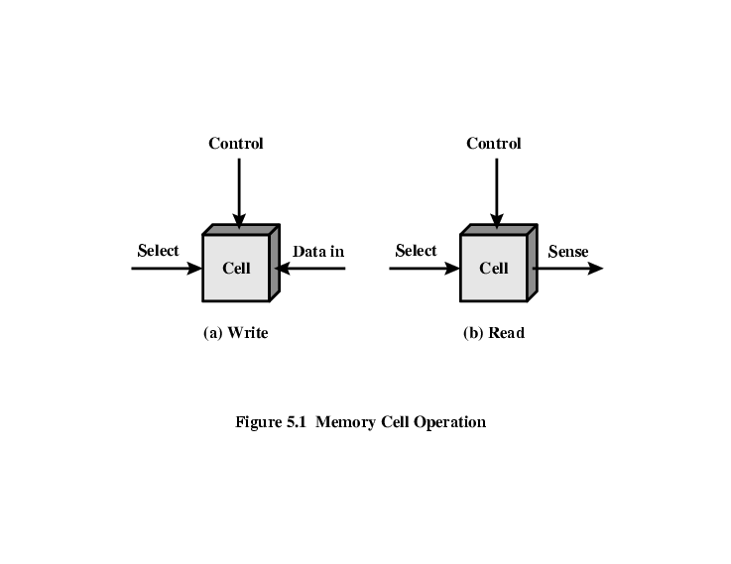
Memory Cell Operation

Slide 7
Types of memories
Two types of memories are used in various parts of a computer system
Random Access Memory (RAM)
Read Only Memory (ROM)

Slide 8
What is RAM
By random access we mean that memory cells can be accessed to transfer information to or from any desired location with the access taking the same time regardless of the location
In contrast, serial/sequential memory such as exhibited by a magnetic disk or tape unit takes different lengths of time to access information, depending on where the desired location is relative to the current physical portion of the disk or tape

Slide 9
Simple block diagram of a RAM
n data input lines
k address lines
Memory unit
2^{k} words
n bits per words
Read
Write
n data output lines

Slide 10
RAM Memory Specifications
The memory unit is specified by the number of words it contains and the number of bits in each word
E.g. 1024 x 16 bit memory means this ram has 1024 words in total and there are 16 bits in each word
We can also refer to this as 2K x 8 bit memory or 1K x 16 bit memory
The address line selects one particular word
Each word in memory is assigned an identification number called an address
Addresses range from 0 to 2^{k-1}, where k is the number of address lines
The selection of specific word inside memory is done by applying k bits binary address to the address line

Slide 11
Control Inputs to RAM Memory
Two types of control inputs to memory are present
Chip select
R/W
Chip Select | R/W | Memory Operation
0 | X | None
1 | 0 | Write
1 | 1 | Read

Slide 12
Properties of RAM
Integrated circuit RAM may be either static or dynamic
Static RAM (SRAM) consists of internal latches that store the binary information
The stored information remains valid as long as power is applied to the RAM
Dynamic RAM stores the binary information in the form of electric charges on capacitors

Slide 13
Static RAM
Bits stored as on/off switches
No charges to leak
No refreshing needed when powered
More complex construction
Larger per bit
More expensive
Does not need refresh circuits
Faster
Cache
Digital
Uses flip-flops

Slide 14
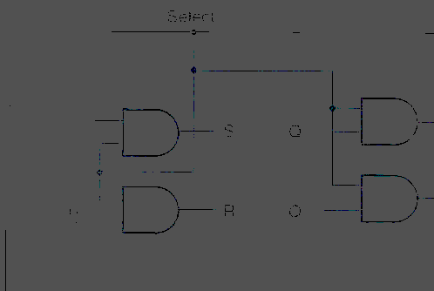
Static RAM Cell

Slide 15
RAM bit slice Model
The interconnection of a set of RAM cells and read and write circuits is called RAM bit slice model

Slide 16
Review Questions
What are the key properties of semiconductor memory?
What are two senses in which the term random-access memory is used?
What is the difference between DRAM and SRAM in terms of application?
What is the difference between DRAM and SRAM in terms of characteristics such
as speed, size, and cost?
Explain why one type of RAM is considered to be analog and the other digital.

Slide 17
Thank you

